Slide 1

Reservation Master
Report
Click to Begin

Slide 2
Error!
Please follow the on-screen
instructions to continue.
Go Back

Slide 3
Complete
Please navigate to the next module
in the course to continue.
Restart Course

Slide 4
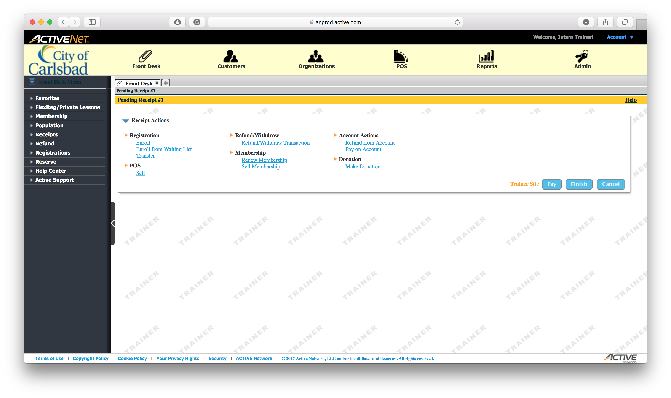
Tip:
Select the Reports module
This is where we print all reports

Slide 5
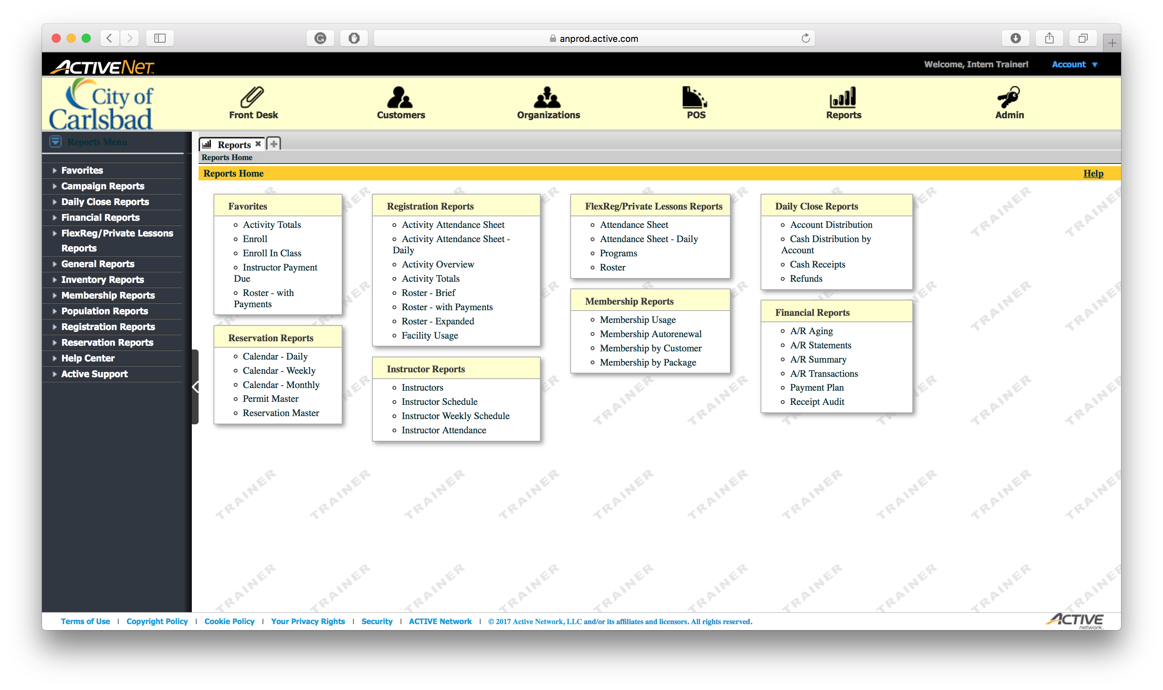
Tip:
Select the Reservation Master option
This can be found in the lower left area of the main page.

Slide 6
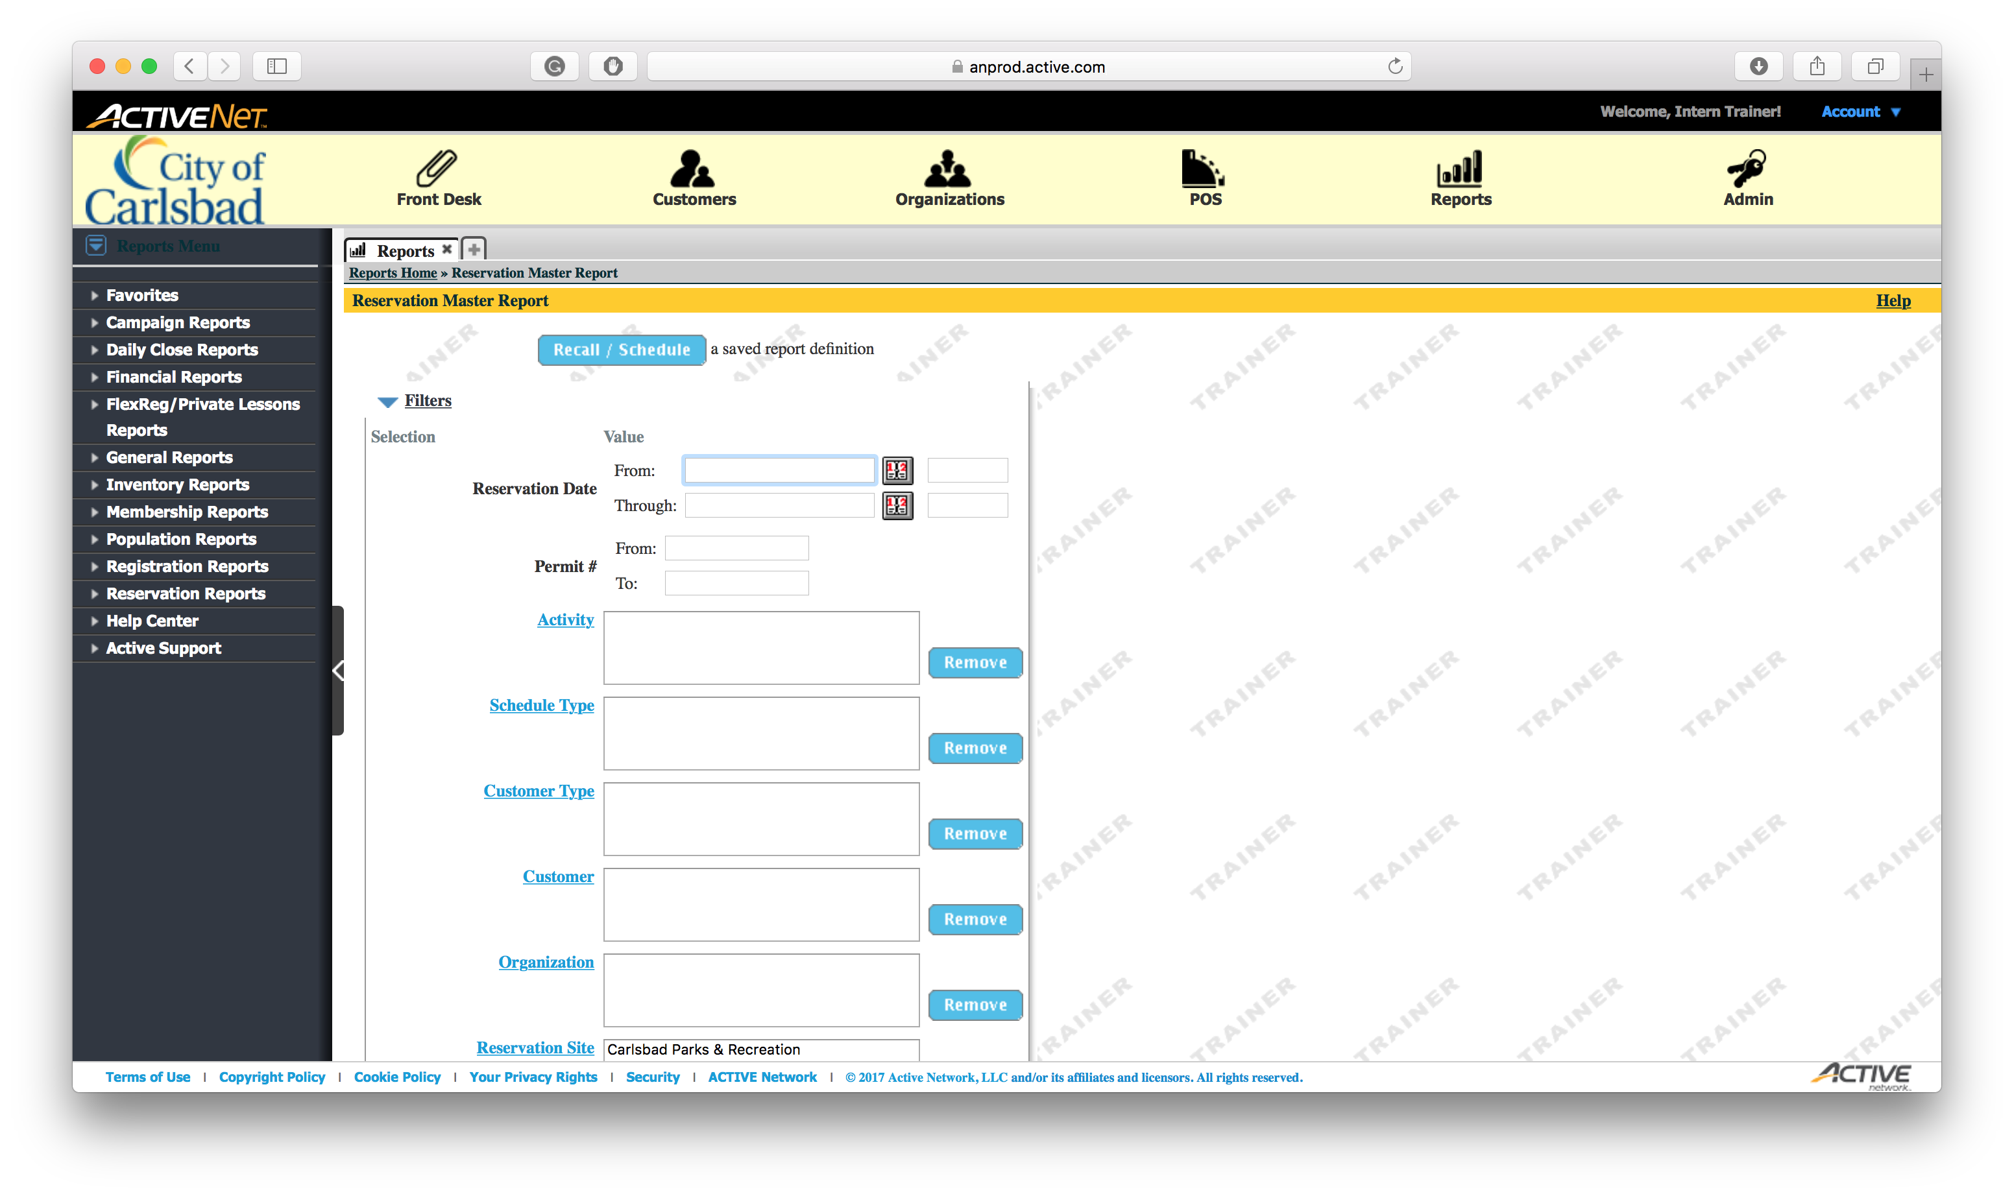
Tip:
Select the Start Date
Not putting a start date returns all data in our system

Slide 7
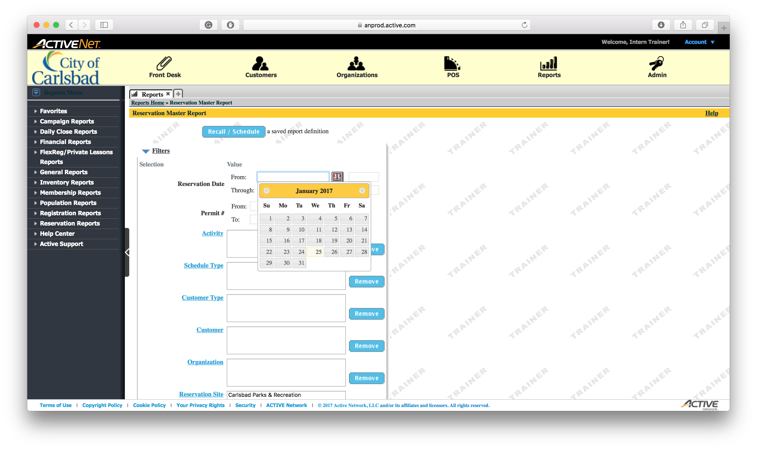
Tip:
Select January 27

Slide 8
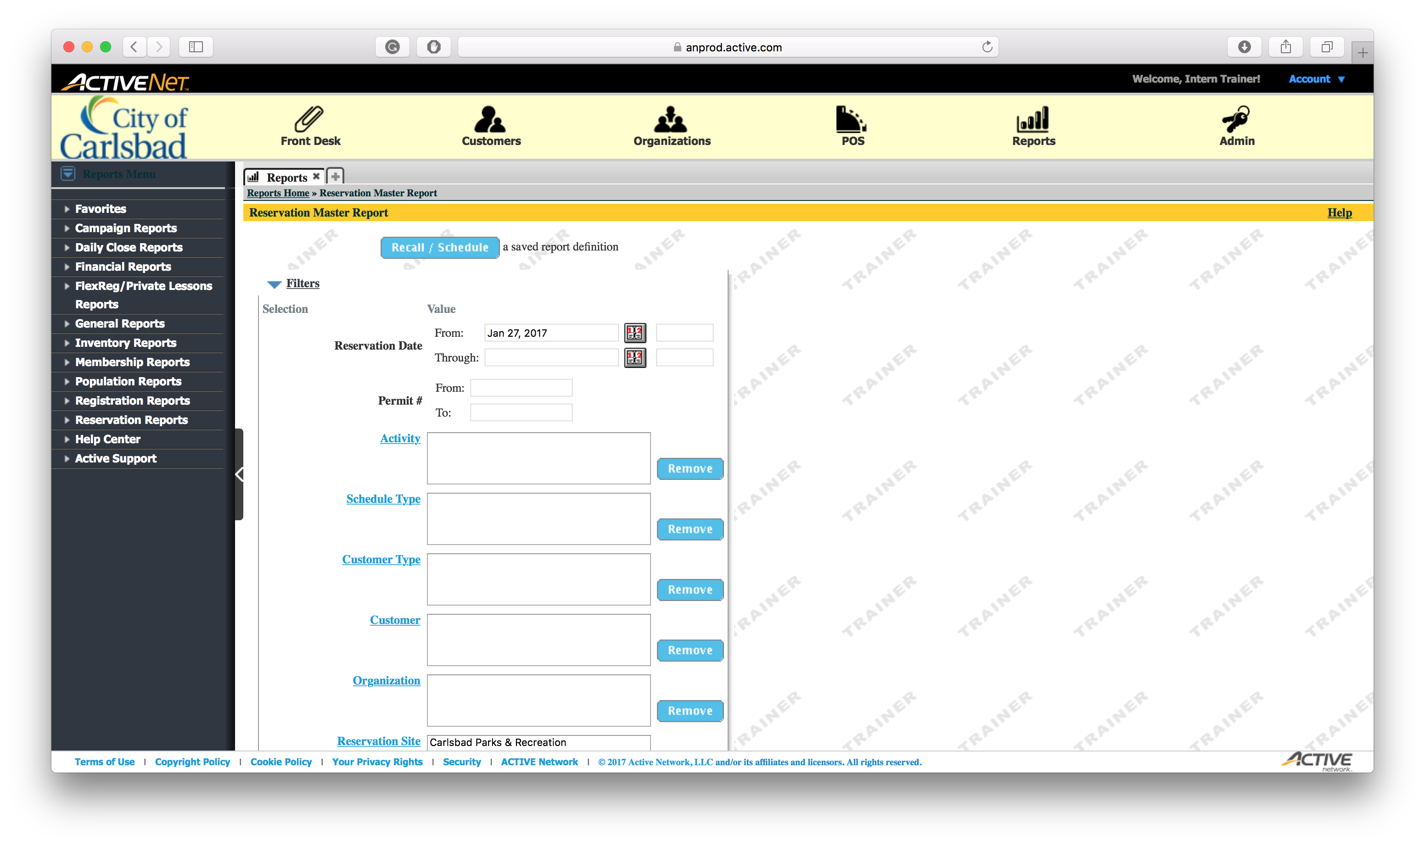
Tip:
Enter the End Date
Not putting an end date gets all future reservations

Slide 9
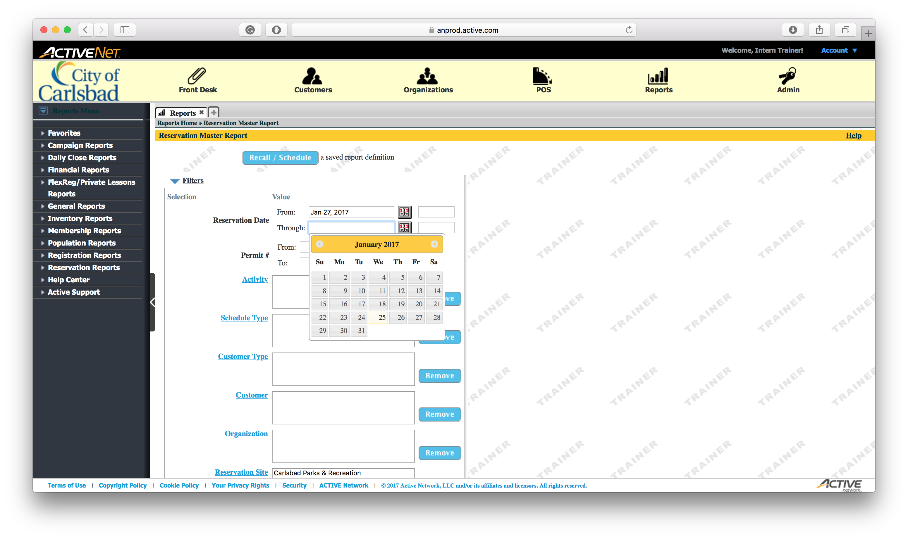
Tip:
Select January 29

Slide 10

Next Page
Tip:
You need to scroll down to see the rest of the filters.
Since we can’t do that here, click the Next Page button.

Slide 11
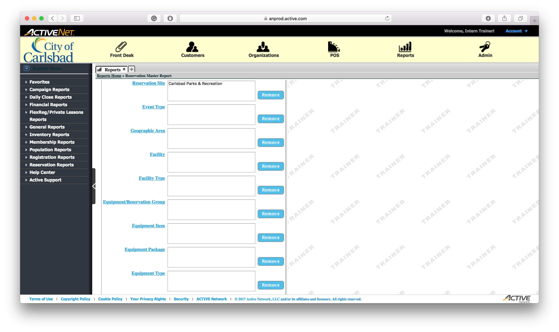
Tip:
Select Facilities from the list.
You can choose one or many locations to print the report for.

Slide 12
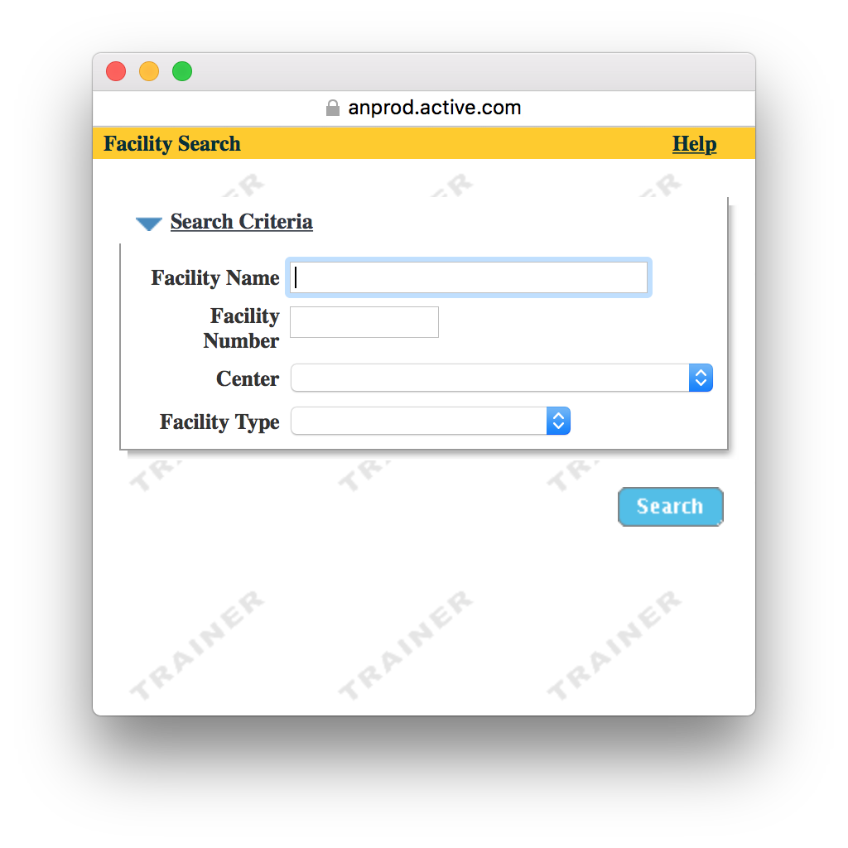
Tip:
Click the Drop-Down menu to view centers

Slide 13
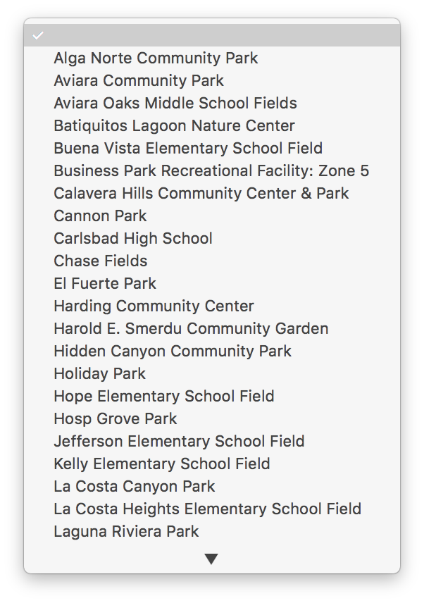
Tip:
Select Calavera Hills
** You may select more than one center by “adding all selected” and returning to this screen – instead of clicking “Done”

Slide 14
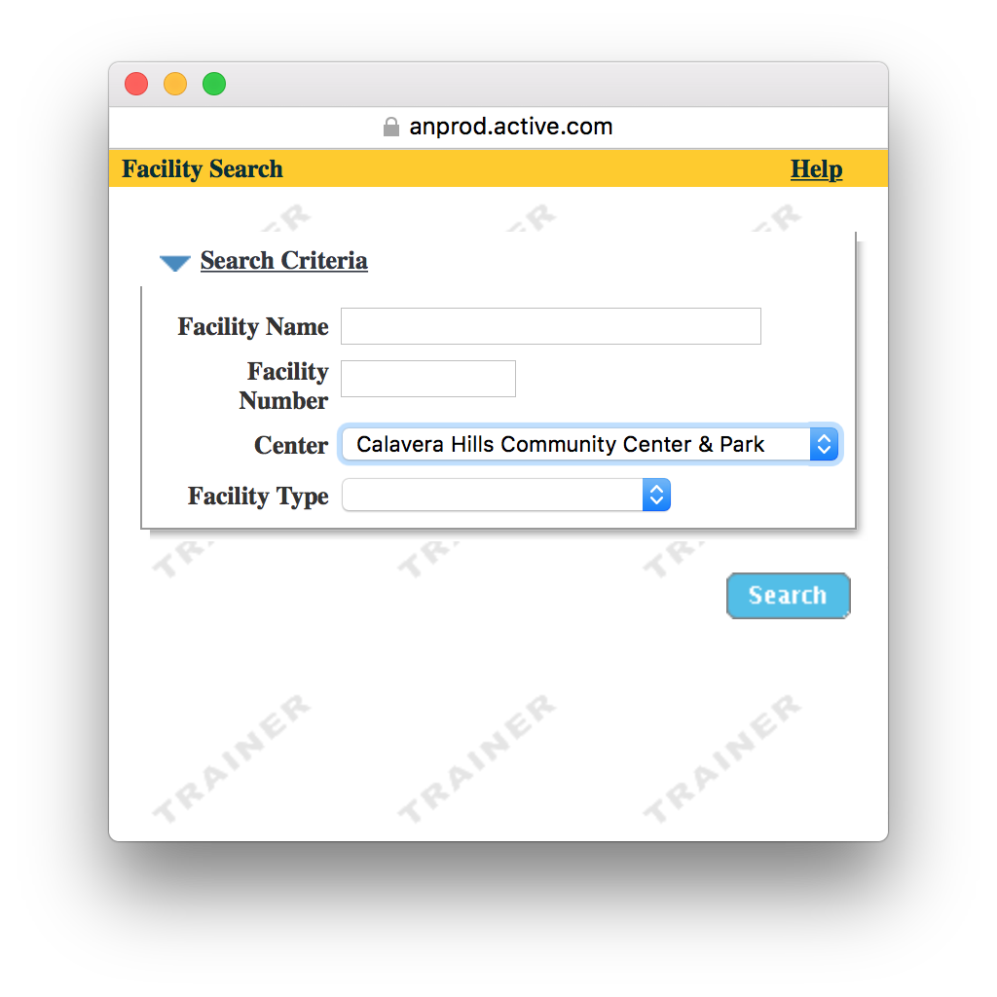
Tip:
Click Search to locate all options
Every facility at Calavera will appear

Slide 15
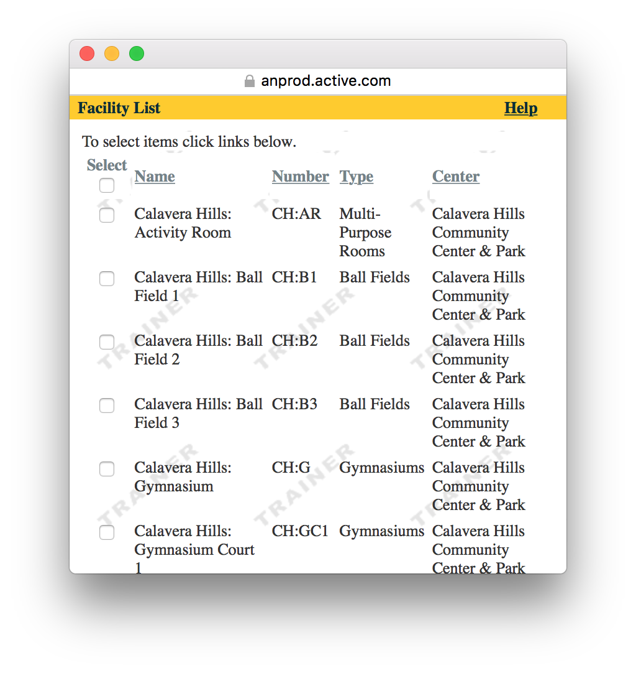
Tip:
Select the top checkbox to select all

Slide 16
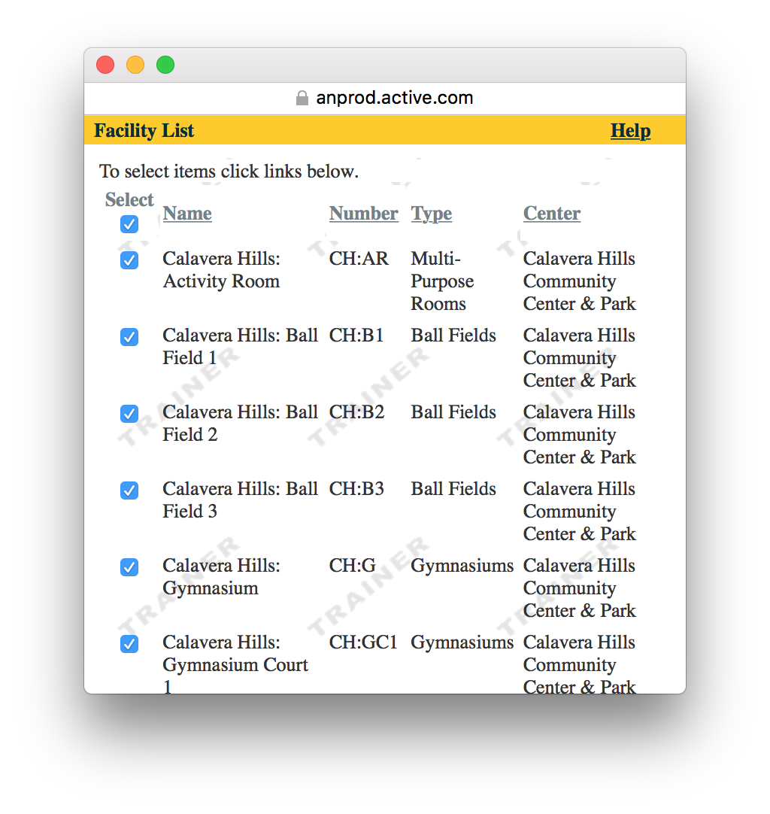
Tip:
Next Page
Scroll down to select Done
We can’t scroll in this tutorial. Please select Next Page

Slide 17
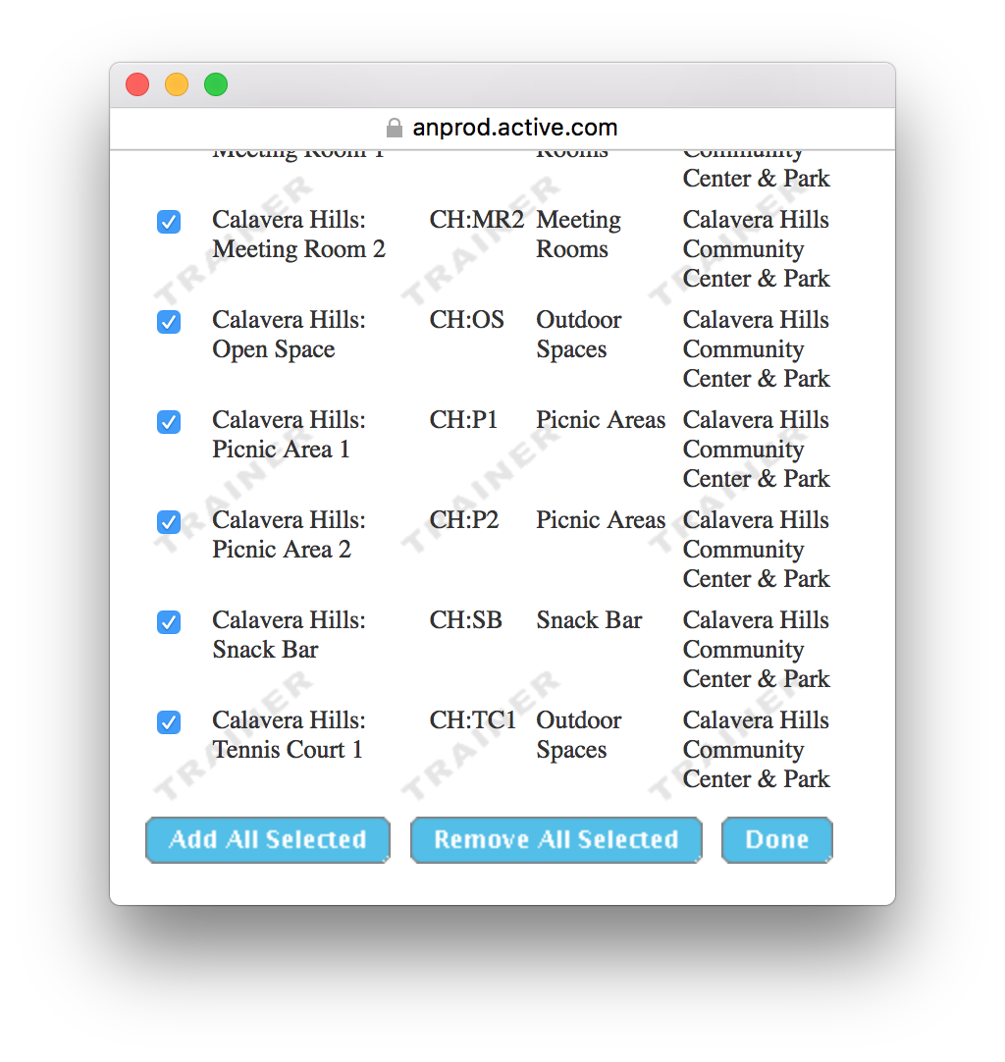
Tip:
Click Done to add all

Slide 18
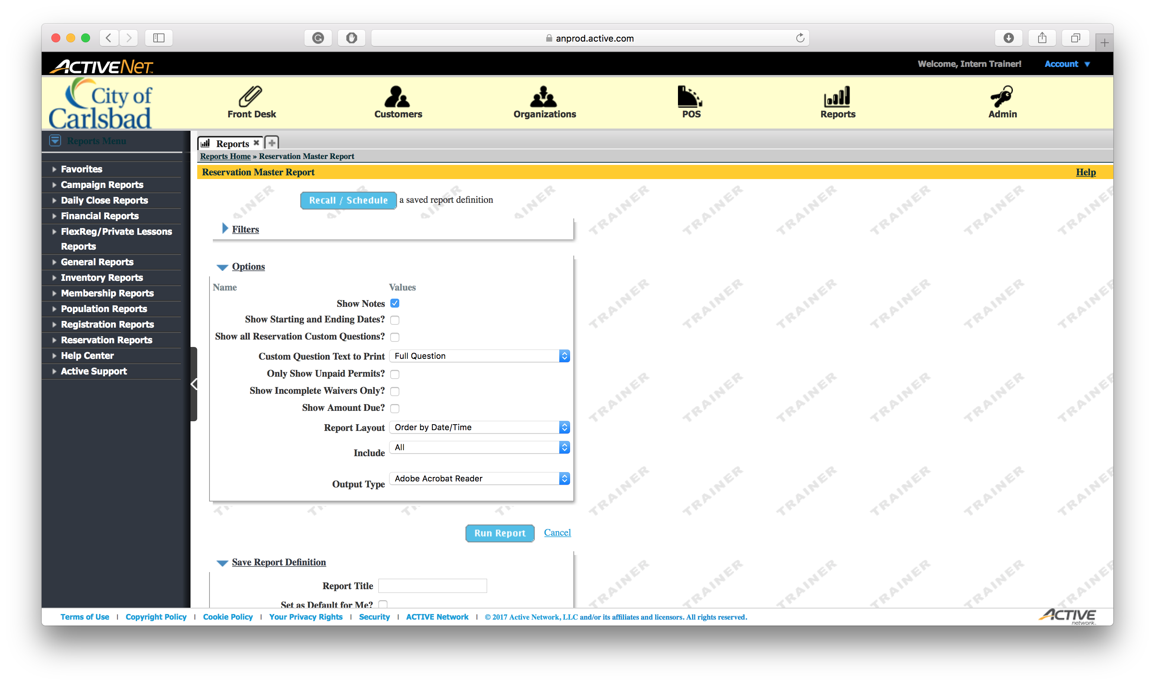
Tip:
Here are some options to add to the report
We are not going to use any of these. To continue, Run the Report

Slide 19
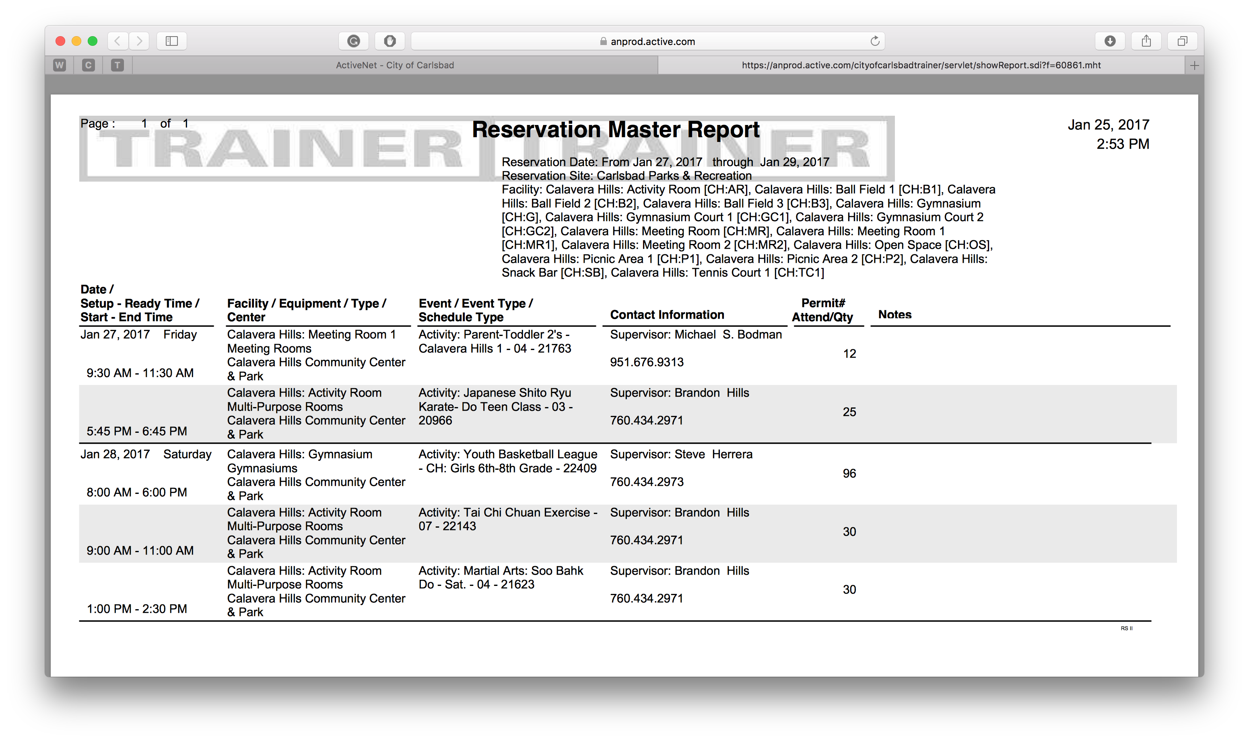
Tip:
Click to Finish
This is what the report looks like
You may use this for facility schedules, weekly reservations and more!

